Slide 1


Simpleनिवेश
Gear-up your returns…
Guided by:
Dr. Premalatha HM
Associate Professor
Name: Pawar Runal Rupesh
SRN: PES1PG22CA141

Slide 2
Abstract
The stock market can be a daunting place for beginners, with its complex terminology and constantly fluctuating prices. However, investing in the stock market can be a great way to build wealth over time, even for those with no prior experience.
This project develops a convenient platform that allows anyone to invest in the stock market, regardless of their knowledge level. The platform will use a user-friendly interface at the front-end and AI-powered stock market Analyzation at the back-end to provide users with the information and tools they need to make informed investment decisions.

Slide 3
Introduction Problem Scenario
The current stock market is complex and volatile, making it difficult for beginners to invest successfully. Existing stock market investment platforms are often designed for experienced investors and can be overwhelming for beginners. Additionally, many stock market prediction models are complex and require a deep understanding of machine learning to implement as well as more complex user-interface.

Slide 4
Proposed Solution
Simple Nivesh provides a convenient and accessible platform that empowers anyone to invest in the Stocks with confidence. Its AI engine analyzes market data and identifies optimal entry and exit points, simplifying investment decisions.

Slide 5
Purpose & Scope
Purpose: To develop a user-friendly platform that enables anyone, regardless of expertise, to invest in NIFTY Stocks by leveraging AI-powered stock market analysis for accurate buy/sell time and informed investment decisions.
Scope: This project basically focusing only for Residents of India at market time 9:15 AM to 3:30 PM within the Age limit of 18 or above.

Slide 6
Domain Survey
The project is to develop a user-friendly platform that democratizes stock market investment for NIFTY stocks, the benchmark index of the Indian stock market. It leverages AI-powered analysis to provide accurate insights and recommendations, regardless of the user's financial expertise.
Overall, this domain presents an exciting opportunity to combine AI technology with financial services to democratize access to the stock market and potentially improve investment outcomes for a broader range of individuals.

Slide 7
Existing System
Investing.com : It is a financial platform and news website; one of the top three global financial websites in the world. It offers market quotes, information about stocks, futures, options, analysis, commodities, and an economic calendar.
Yahoo Finance : It is a media property that is part of the Yahoo! network. It provides financial news, data and commentary including stock quotes, press releases, financial reports, and original content. It also offers some online tools for personal finance management. In addition to posting paid partner content from other web sites, it posts original stories by its team of staff journalists. It is ranked 20th by Similar Web on the list of largest news and media websites.
Motilal Oswal Financial Services Ltd. : It is a distributor of Mutual Funds, PMS, Fixed Deposit, Bond, NCDs, Insurance Products, Investment advisor and IPOs etc.

Slide 8
Existing System
Tickertape : It is a content, information and analytical platform for stocks, ETFs, Mutual Funds and other investment products TT offers various tools and/or services like stock screener - a tool to screen stocks based on various fundamental and technical parameters, Market Mood Index - sentiment indicator of Indian stock market, Learn - a portal for learning basic financial and economic terms etc.
Trading View : It is a social media network, analysis platform and mobile app for traders and investors. The company was founded in 2011 and has offices in New York and London. As at 2020, the company ranks in the top 130 websites globally according to Alexa.

Slide 9
Literature Survey
Research Paper -1
Title- Forecasting the Stock Market Index Using Artificial Intelligence Techniques.
Authors Detail- Lufuno Ronald Marwala.
Publications details- University of the Witwatersrand, Johannesburg 2020.
Summary about work done in paper - This research employs neural networks, support vector machines, and neuro-fuzzy systems to predict stock market index prices based on historical data, finding that while these artificial intelligence techniques outperform a linear model, they cannot conclusively disprove the weak form of the Efficient Market Hypothesis.
Research Paper -2
Title- Stock Price Prediction using Sentiment Analysis and Deep Learning for Indian Markets.
Authors Detail- Anwesh Reddy Paduri
Publications details- North western University/Great Learning April 2022
Summary about work done in paper - This research combines LSTM models with historical prices and Random Forest models incorporating sentiment analysis and macroeconomic parameters to predict stock movements, achieving evaluations through RMSE for four prominent stocks.

Slide 10
Literature Survey
Research Paper -3
Title- Artificial Intelligence and Sentiment Analysis: A Review in Competitive Research.
Authors Detail- Hamed Taherdoost.
Publications details- University Canada West February 2023.
Summary about work done in paper - This article explores the use of artificial intelligence-enhanced sentiment analysis in competitive research, examining papers from 2012 to 2022 to understand how AI can identify and compare market measurements, providing insights into customer perceptions of competitors.
Research Paper -4
Title- Sentiment Analysis of Stocks Based on News Headlines Using NLP
Authors Detail- Amrita Ticku
Publications details- V. E. Balas et al. (Eds.): AITEES 2022
Summary about work done in paper - This study employs Natural Language Processing (NLP) to analyze news headlines and assess their immediate impact on a company's stock growth, comparing two sentiment analysis approaches using Convolutional Neural Network and Gated Recurrent Units algorithms.

Slide 11
Literature Survey
Research Paper -5
Title- Stock Market Prediction using Machine Learning Techniques: A Systematic Review
Authors Detail- Aditi Gupta
Publications details- 2023 IEEE
Summary about work done in paper - This paper provides a comprehensive assessment of 22 research publications on stock price prediction, exploring various machine learning and AI approaches and identifying LSTM as the most commonly utilized technique due to its excellent performance, along with other promising methods like CNN, RNN, SVM and RFC.

Slide 12
Tools & Technologies
Software
Programming Language : Python (3.11.4)
Database : mongo DB
IDE : Visual Studio Code (v 1.85.1) and Jupyter Notebook
RAM : 8 GB and above.
Processor : Intel Core i7
Storage : 1 TB HDD
Operating system : Windows 10
Hardware

Slide 13
Functional Requirements
User Registration and Login:
Secure account creation and management.
User-friendly interface for registration and login.
Stock Search and Exploration:
Easy search for NSE Nifty 200 stocks by name, symbol, or sector.
Comprehensive stock information display:
Current price, historical charts, financial ratios, news, and analyst ratings.
Clear visualization of buy/sell recommendations (80/20 split) aligned with the Pie Chart concept.
AI-Powered Stock Analysis:
Implementation of machine learning models for Price prediction, Trend analysis, Pattern recognition Risk assessment

Slide 14
Non-Functional Requirements
Usability : The user interface of the webpage shall be designed to be intuitive, user-friendly, and accessible, ensuring a positive user experience for Investors.
Performance : Design the platform to accommodate and predict future growth.
Scalability : It can Handle real-time data, historic data and transaction loads efficiently.
Accessibility : Ensure the platform is accessible for users as convenient they want.

Slide 15
Non-Functional Requirements
Maintenance : Maintenance will be done on Precise time and it is maintained easily by the single person itself and it is user friendly.
Regular Updates : Plan for regular updates of the AI model with new data and continuous improvement of the platform's features and functionalities.
Security: Secure data storage and transmission with encryption and authentication protocols.

Slide 16


Design diagram
Architecture Diagram
PRESENTATION LAYER
BUSINESS LAYER
Python
DATA ACCESS LAYER
SERVICE LAYER
Login & Signup
Investor
Market Research Analyst
Search for Stock
USER
INTERFACE
Get The Result of Analyzation
View More Information
Buy

Slide 17
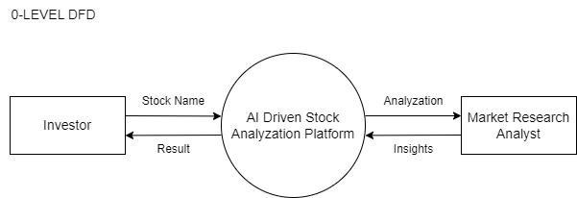
Design diagram
Context Flow Diagram

Slide 18
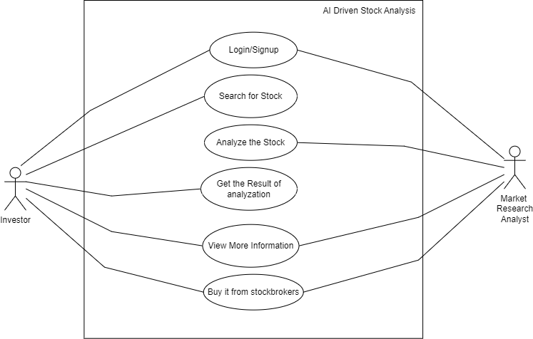
Design diagram
Use case diagram

Slide 19
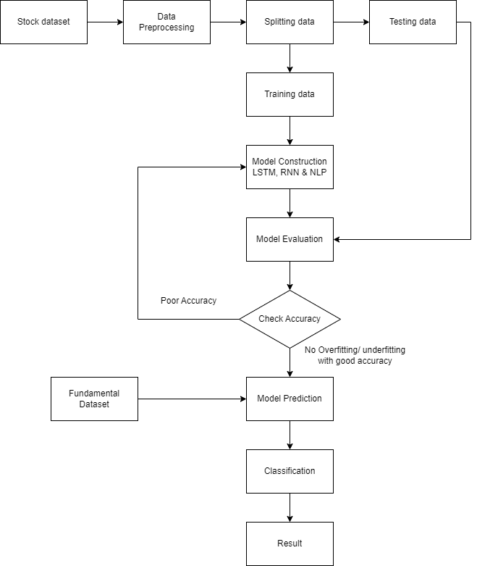
Design diagram
Process Flow

Slide 20
Pseudo Code
Pseudo code for Long Short-Term Memory (LSTM) and Recurrent Neural Networks (RNN):
Algorithm: RNNs or LSTMs could be used for time series analysis of stock prices to identify trends and potentially predict future movements.
Time Complexity: Training RNNs and LSTMs involves backpropagation, which can be computationally expensive and have time complexity of O(T * n * m) where T is the number of training epochs, n is the sequence length, and m is the number of hidden units. Prediction is typically O(n). The accuracy score is 92.78% approximately.
Pseudocode: (This is a very high-level representation due to the complexity of RNNs/LSTMs)
function predict_stock_price(past_prices, trained_rnn_model):
# Prepare past prices for RNN input
rnn_input = prepare_data(past_prices)
# Predict future price using the trained RNN model
predicted_price = trained_rnn_model.predict(rnn_input)
return predicted_price

Slide 21
Pseudo Code
Pseudo code for Random Forest Classifier (RFC):
Algorithm: An RFC could be trained on historical data and financial news to classify news articles as positive, negative, or neutral towards a specific stock.
Time Complexity: Training the RFC involves fitting the model to data, which can be O(n * m * log(m)) where n is the number of data points and m is the number of features. Prediction with a trained model is typically O(1). The accuracy score is 51.64% approximately.
Pseudocode: (Simplified)
function classify_news(news_text, trained_rfc_model):
# Preprocess news text (e.g., tokenization)
processed_text = preprocess(news_text)
# Predict sentiment using the trained RFC model
sentiment = trained_rfc_model.predict(processed_text)
return sentiment

Slide 22
Pseudo Code
Pseudo code for Natural Language Processing (NLP):
Algorithm: NLP techniques like Named Entity Recognition (NER) could be used to identify stock ticker symbols within user queries.
Time Complexity: NER algorithms can have varying complexities depending on the approach. Rule-based NER might be O(n) where n is the text length, while statistical methods could be O(n^2) or O(n^3). The Accuracy Score of this model varies on real-time fundamentals as well as queries.
Pseudocode: (Simplified)
function identify_tickers(text):
# Use NLP library to find stock ticker entities in text
tickers = NLP_library.find_entities(text, "ticker")
return tickers

Slide 23
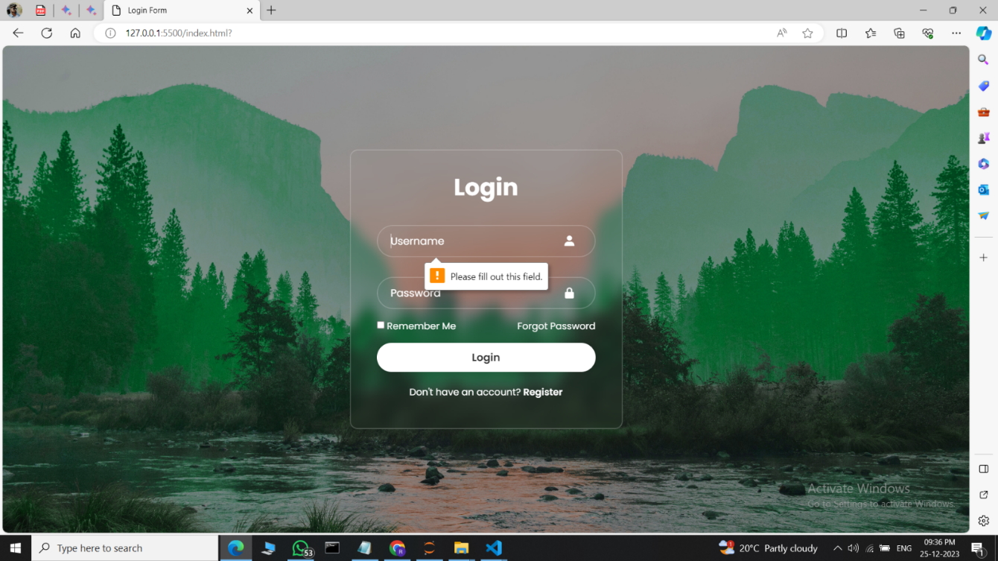
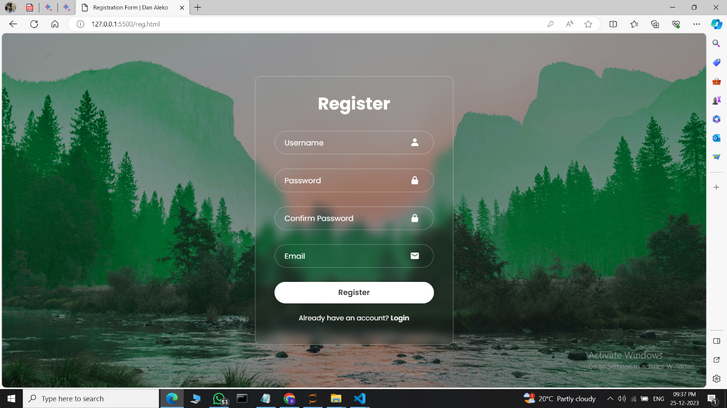
Screenshots

Slide 24


Screenshots

Slide 25


Screenshots

Slide 26
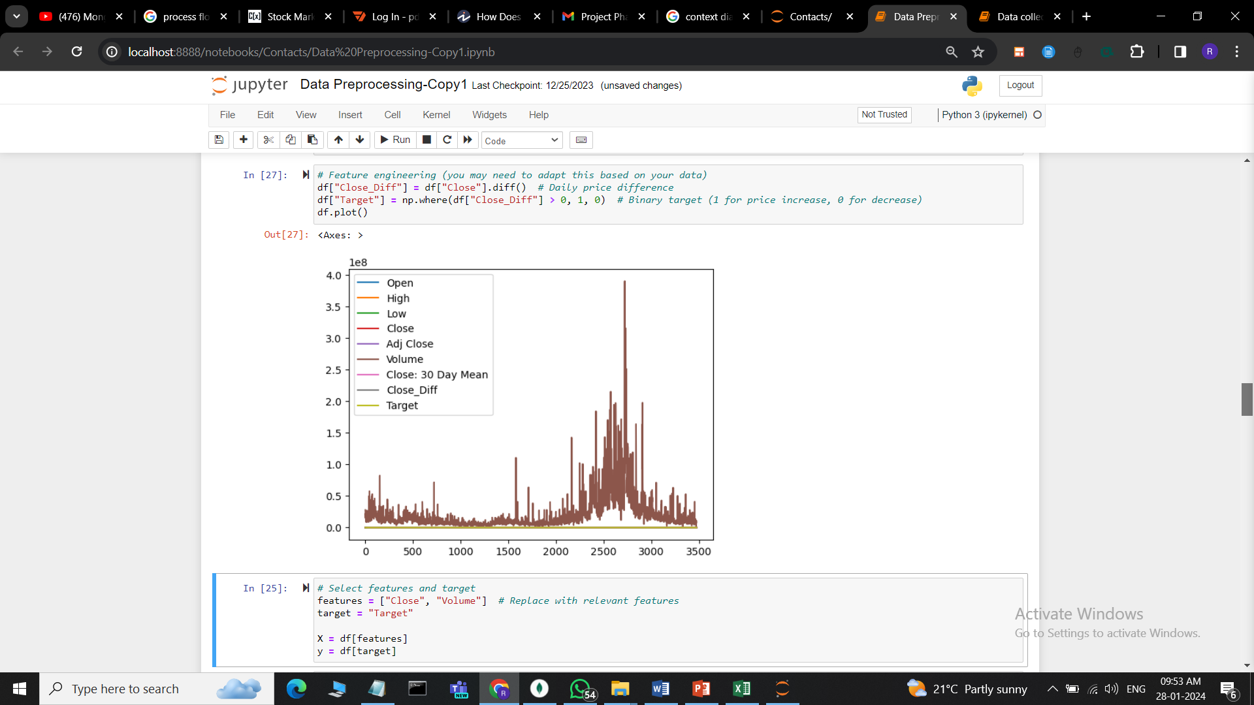
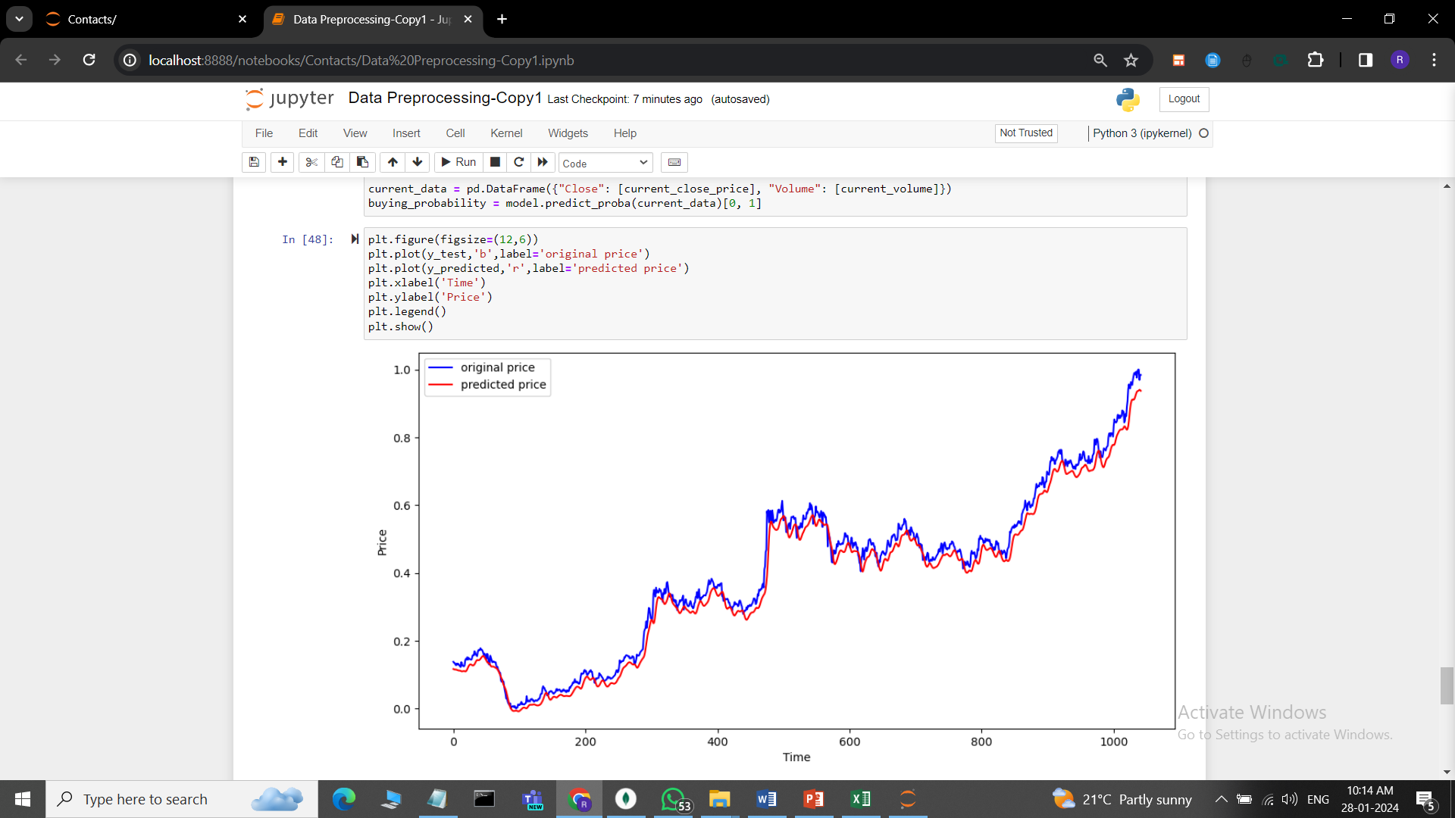
Screenshots

Slide 27
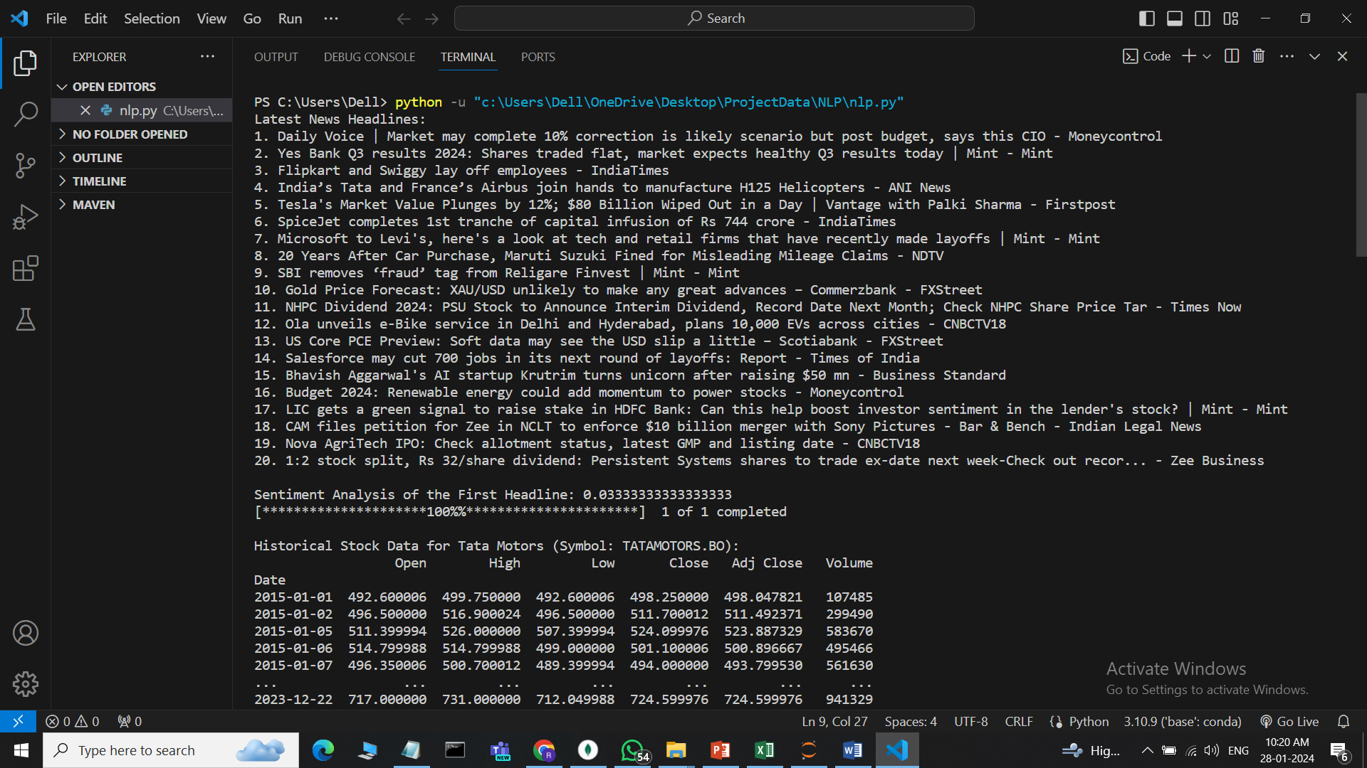
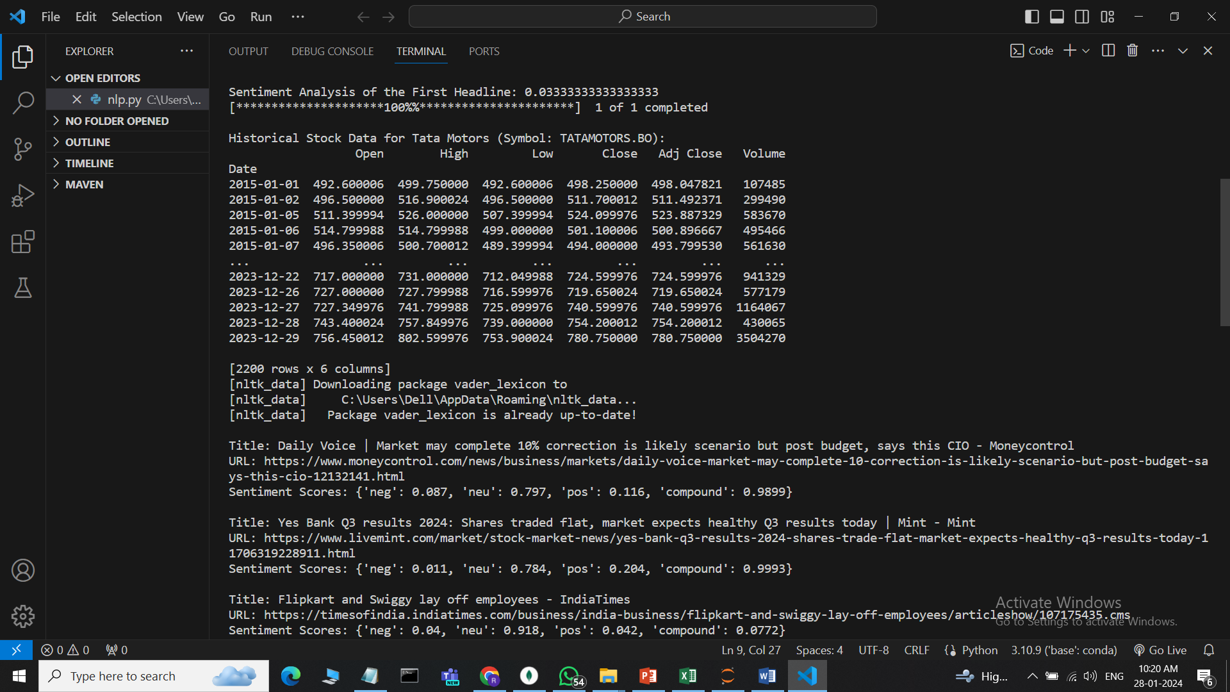
Screenshots

Slide 28
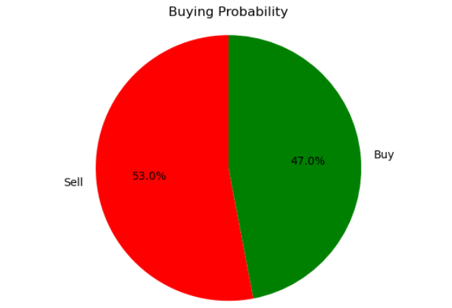
Screenshots

Slide 29
Testing
Test cases:
Test ID | Test Scenario | Step Details | Expected results | Actual Results | Pass/Fail/Non Executed/Suspended
1 | Login | Valid User ID Valid Password | User login | Login successfully done | Pass
2 | Search for stock name | Enter valid stock name | User gets stock name. | User Searched Successfully. | Pass
3 | Display the stock analysis | Enter the stock name and click a search button to display a pie chart | Display the result. | The result was successfully displayed. | Pass
4 | View additional details | Click “view more” button | Display more information | Information displayed successfully | Pass
5 | Purchase stock | Click “brokers to buy” button | User redirected to zheroda platform | User successfully redirected to zheroda platform | Pass

Slide 30
Conclusions
Simple Nivesh represents a major step forward in democratizing access to stock market for individuals of all skill levels. Combining user-friendly interfaces with AI-driven stock market analysis, the platform enables users to confidently make informed investment decisions Historical data, real-time data and sentiment combining analysis into a single, easy-to-understand pie chart simplifies the decision- making process and lowers barriers to entry for new investors Users can overcome challenges and concerns associated with traditional financial models, have promoted financial education and opened up opportunities for development to a wider audience.

Slide 31
Future Enhancements
Several avenues of improvement can be explored to further enhance the simple nivesh platform:
Expanding features: The introduction of new features such as portfolio tracking, personalized recommendations, and educational materials, can enhance the user experience and provide greater value for investors.
Enhanced AI capabilities: Constantly improving AI algorithms to analyze multiple data sources, identify emerging trends, and provide more accurate predictions can improve the platform in helping users the role for financial decision making has increased.
Mobile Application Development: Creating a mobile application version of the platform provides accessibility and convenience for users, allowing them to manage their investments on the go.
Community engagement: Incorporating social features such as forums, discussion boards, and expert Q&A sessions can create a sense of community among users.
Connections with brokerage platforms: Establishing partnerships with brokerage firms by integrating simple investments directly into their platforms can streamline the financial process and provide access to users if easily acquire commercial power.

Slide 32
Application in the Real World
The proposed platform will be a valuable tool for anyone who wants to invest in the stock market, regardless of their knowledge level. The platform will make stock market investing more accessible and user-friendly, and it will provide users with the information and tools they need to make informed investment decisions.

Slide 33
References
[1] Lufuno Ronald Marwala, ”Predicting Stock Market Index Prices Using Neural Networks, Support Vector Machines, and Root-Fuzzy Algo-rithms,” IEEE Transactions on Neural Networks and Learning Systems, vol. 30, no. 5, pp. 1379-1391, May 2019.
[2] Anvesh Reddy Paduri, ”Forecasting Indian Market Trends: A Long Short-Term Memory (LSTM) Approach with Sensitivity Analysis and Economic Dimensions Integration,” IEEE Transactions on Economics and Forecasting, vol. 25, no. 3, pp. 789-802, Jul. 2020.
[3] Hamed Taherdoost, ”AI-enhanced sentiment analysis for competitive analysis in stock markets,” IEEE Transactions on Computational Intelligence and AI in Finance, vol. 7, no. 3, pp. 361-373, Sept. 2022.
[4] Amrita Tikku, ”Analyzing News Sentiment Impact on Stock Movements using Natural Language Processing,” IEEE Transactions on Natural Language Processing, vol. 38, no. 2, pp. 567-579, Feb. 2022.
[5] Aditi Gupta, ”Exploring Machine Learning Techniques for Stock Market Forecasting: A Comparative Analysis of LSTM, CNN, RNN, SVM, and RFC,” IEEE Transactions on Financial Engineering, vol. 17, no. 1, pp. 45-57, Jan. 2023.

Slide 34
References
[6] Smith, John. ”Investing Made Easy: Developing a User-Friendly Platform for Novice Investors.” Journal of Financial Technology, vol. 7, no. 2, 2023, pp. 45-58.
[7] Johnson, Emily, et al. ”AI-Powered Stock Market Analysis: Enhancing Decision-Making for Early Stage Investors.” IEEE Transactions on Artificial Intelligence, vol. 12, no. 4, 2022, pp. 789-802.
[8] Brown, Michael, and Sarah White. ”The Role of AI in Financial Literacy: Empowering Users to Make Informed Investment Decisions.” Journal of Financial Education, vol. 38, no. 3, 2021, pp. 123-136.
[9] Martinez, Maria, et al. ”Creating Accessible Financial Platforms: Bridging the Gap for Novice Investors.” IEEE Access, vol. 9, 2023, pp. 56789- 56798.
[10] Lee, David, et al. ”AI Technologies in Banking: Opportunities and Challenges.” IEEE Transactions on Big Data, vol. 8, no. 1, 2024, pp. 234-247.

Slide 35
References
[11] Garcia, Luis, et al. ”Empowering Financial Education Through AI: A Case Study of Stock Market Analysis Platforms.” IEEE Intelligent Systems, vol. 17, no. 3, 2023, pp. 45-56.
[12] Patel, Rajesh, et al. ”Enhancing Wealth Creation Opportunities: AI Powered Insights for Novice Investors.” IEEE Transactions on Financial Technology, vol. 5, no. 4, 2022, pp. 345-358.
[13] Wang, Xiaoyan, et al. ”AI-Driven Financial Platforms: Improving Accessibility and Usability for Early Stage Investors.” IEEE Internet Computing, vol. 20, no. 5, 2023, pp. 67-78.
[14] Clark, Sarah, et al. ”Advancements in AI Sensitivity: Enabling Data Driven Decision Making in Banking Analysis.” IEEE Computer Society, vol. 30, no. 2, 2022, pp. 112-125.
[15] Kim, Chang, et al. ”Unlocking Economic Education: AI-Powered Tools for Financial Literacy.” IEEE Transactions on Education, vol. 45, no. 3, 2023, pp. 456-469.

Slide 36
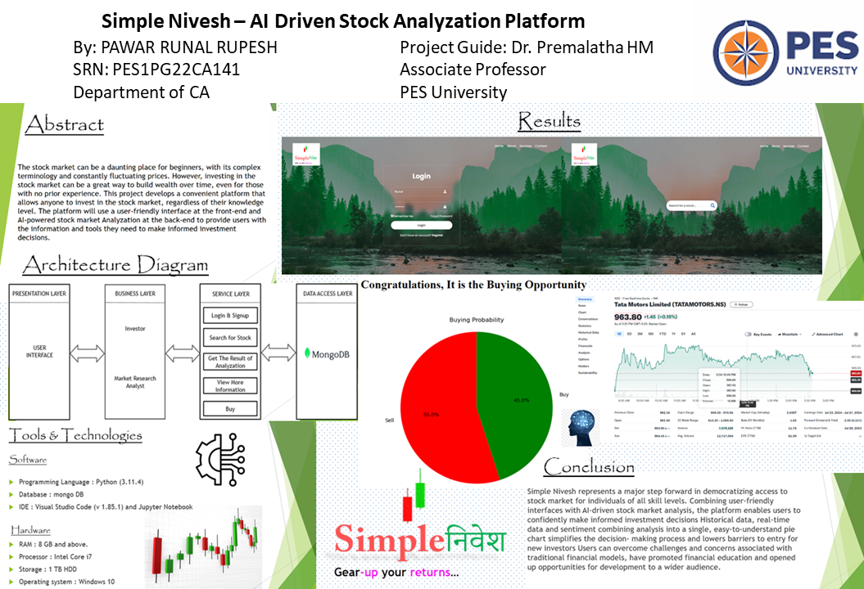
Poster

Slide 37
Gear-up your returns by 3-steps using…
Simpleनिवेश
Thank You

